Slide 1

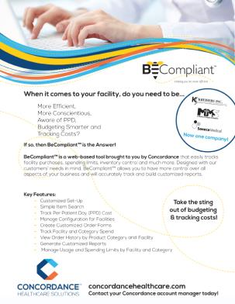
BeCompliant™
A proprietary web-based tool for tracking and comparing spend and usage
Provides access to view order history and patterns by item, category, suppliers and users
Ensures formulary compliance and budget limits are met
Generate real time customized reports

Slide 2
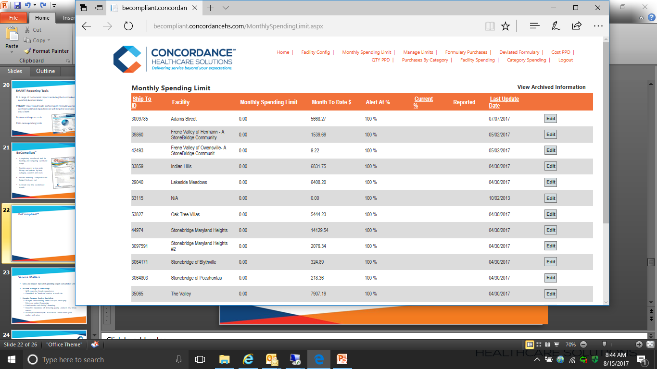
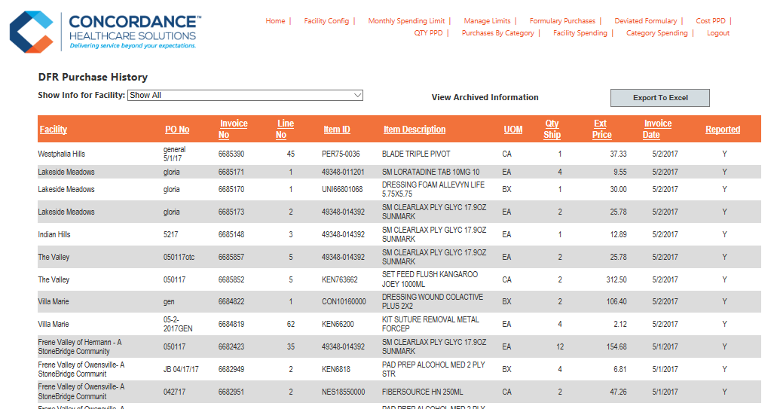
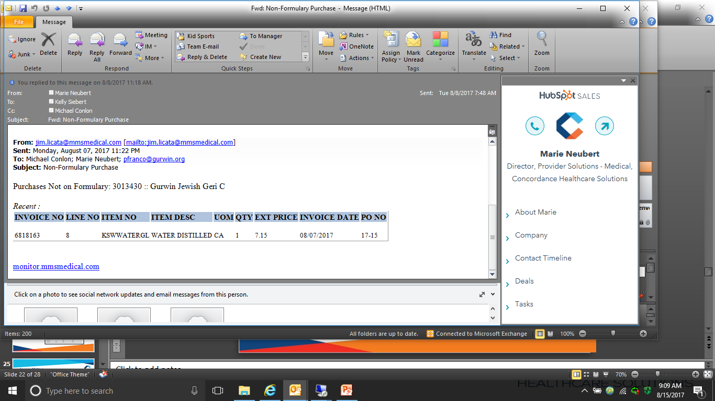
BeCompliant™ Budget and Formulary Alerts

Slide 3
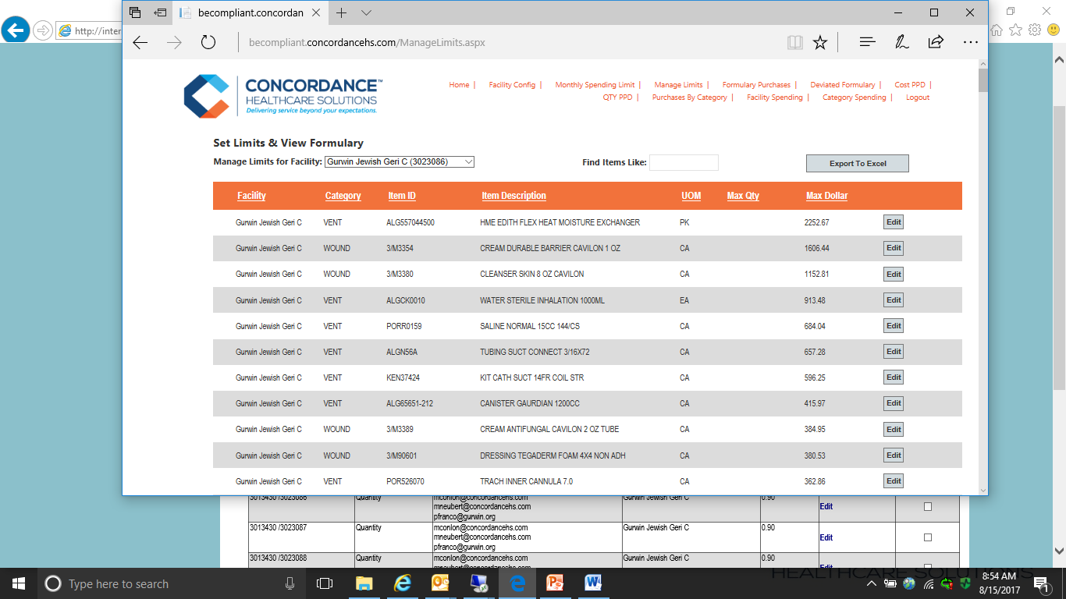
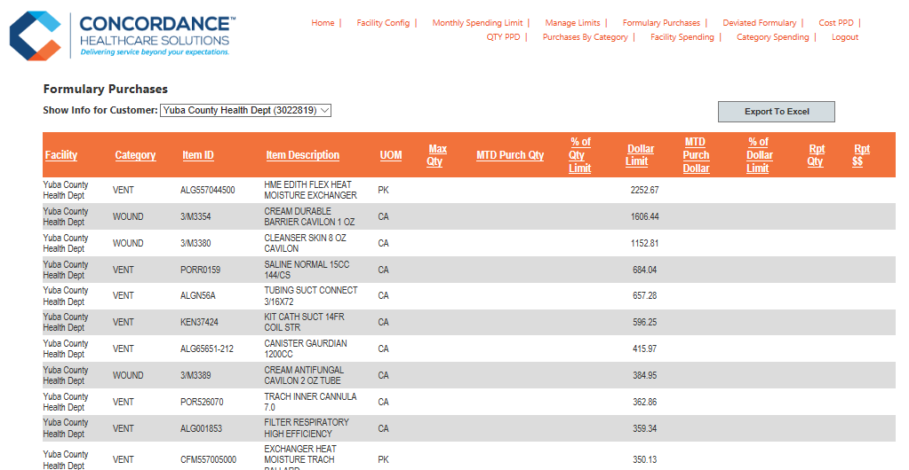
BeCompliant™ Formulary Limits & Tracking

Slide 4
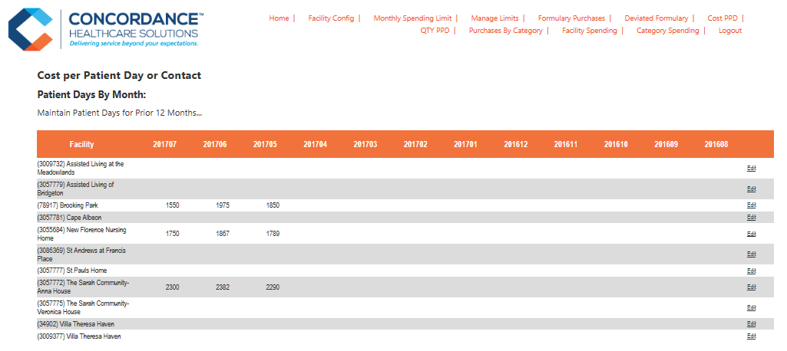
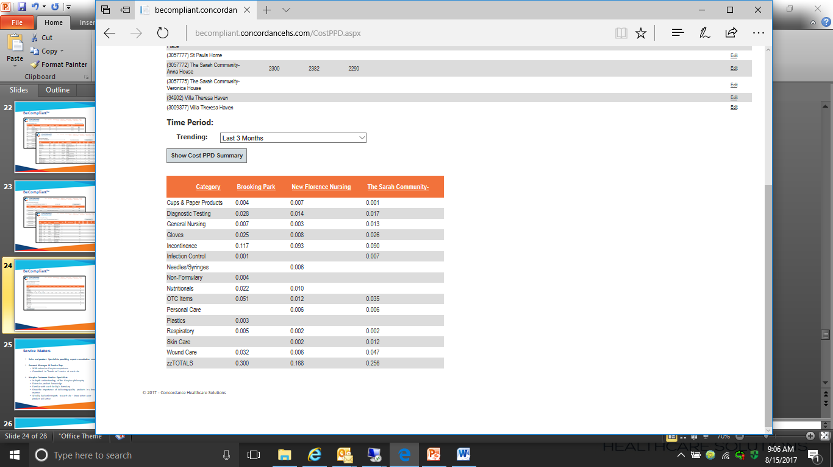
BeCompliant™ Cost Per Patient Day Analysis

